Slide 1
Joint Water Commission
Water Treatment Plant
Virtual Tour

Slide 2
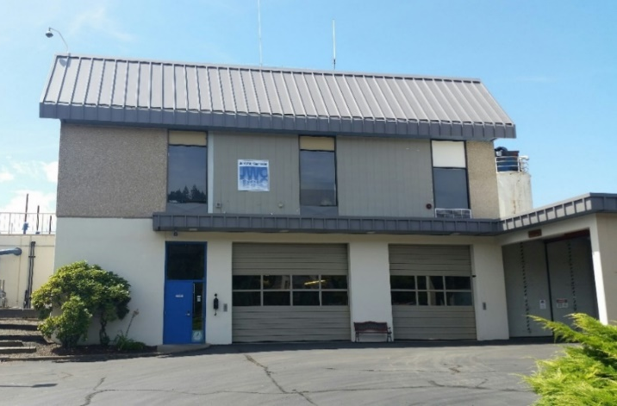
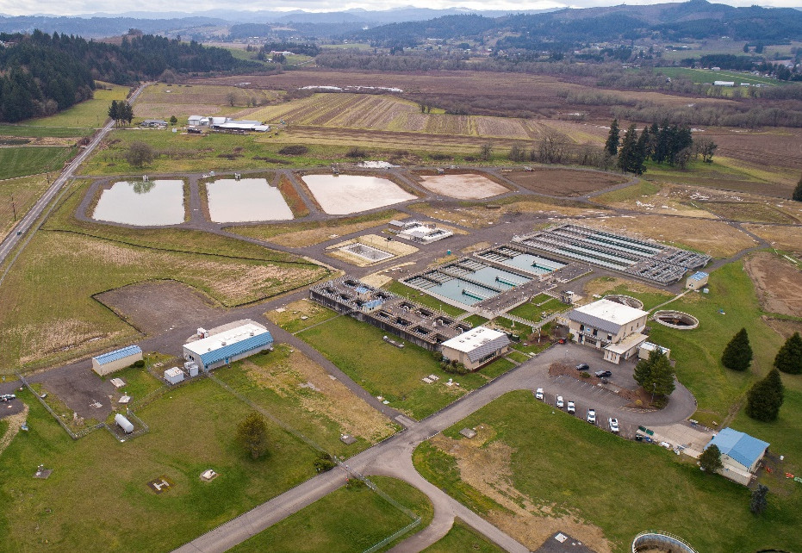
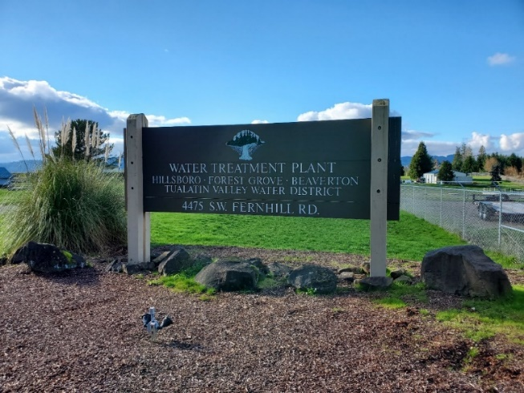

Slide 3




Joint Water Commission
The JWC is a partnership agency between the cities of Beaverton, Forest Grove, Hillsboro and the Tualatin Valley Water District (TVWD). The City of Hillsboro manages the JWC and its employees.

Slide 4
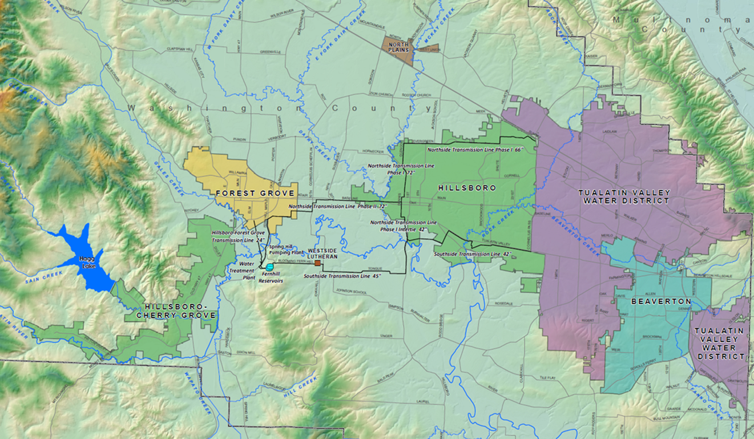

Joint Water Commission
Serves about 450,000 customers in Washington County.
Notes:
Located near Forest Grove

Slide 5
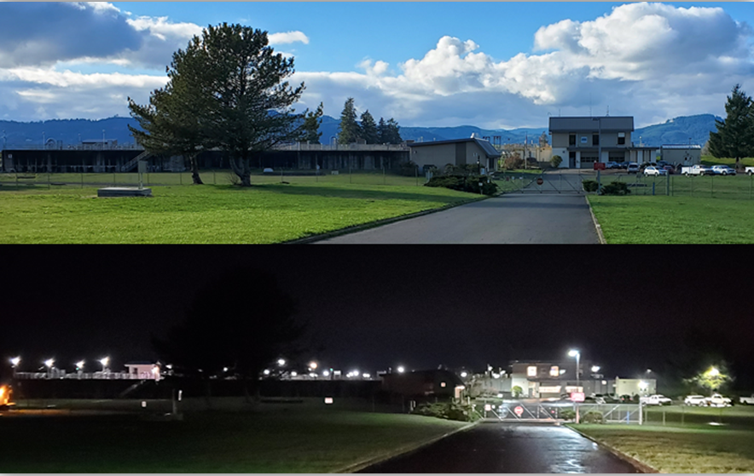
Joint Water Commission
Largest conventional water treatment plant (WTP) in Oregon with a peak capacity of 85 million gallons of water per day (MGD).
Notes:
What does conventional mean? mixing, flocculation, sedimentation, filtration, and chlorine disinfection
24 hours/day, 365 days a year. That means holidays and weekends

Slide 6
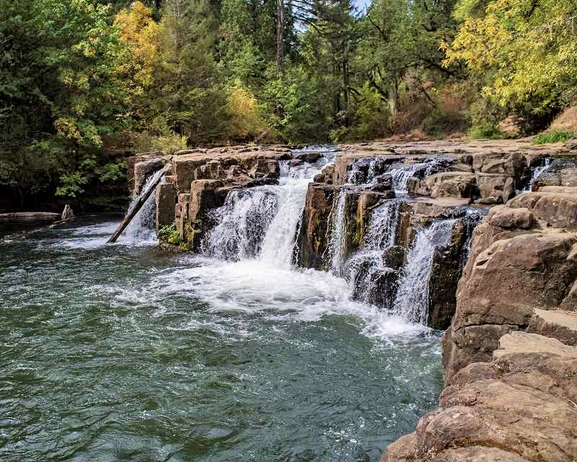
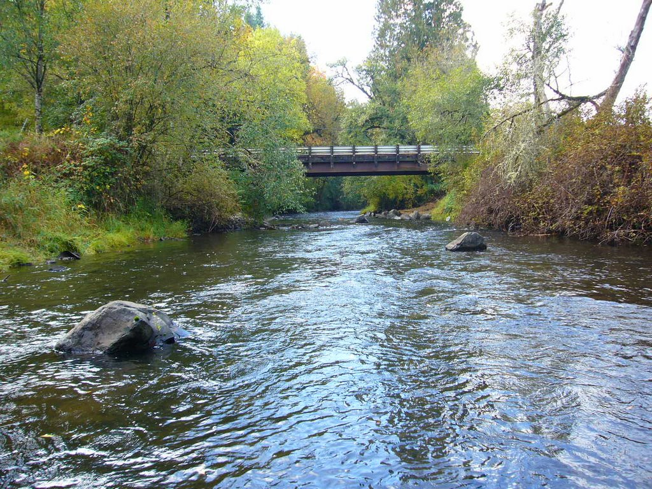
Tualatin River
Notes:
Normally water comes from the Tualatin River

Slide 7
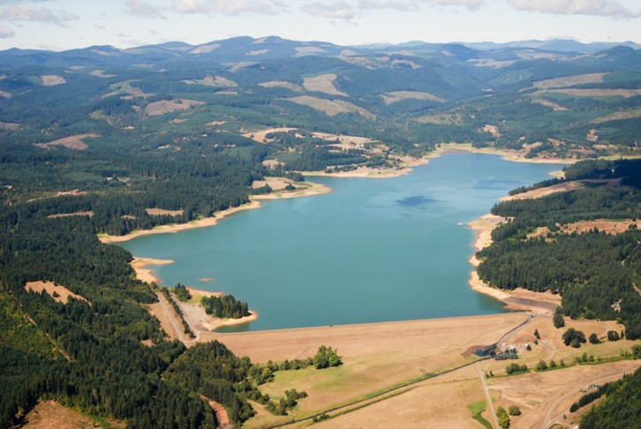
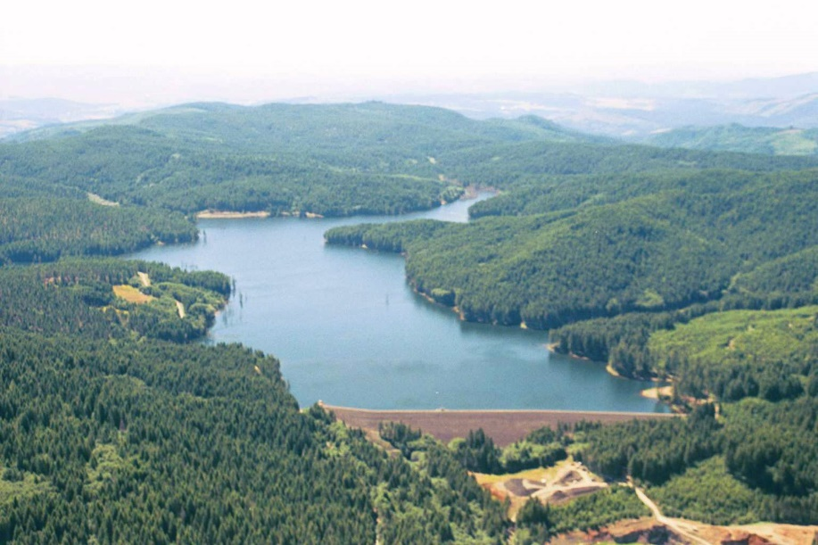
Hagg Lake & Barney Reservoir
Notes:
In the summer we supplement the lower river with water from hagg lake and barney reservoir

Slide 8
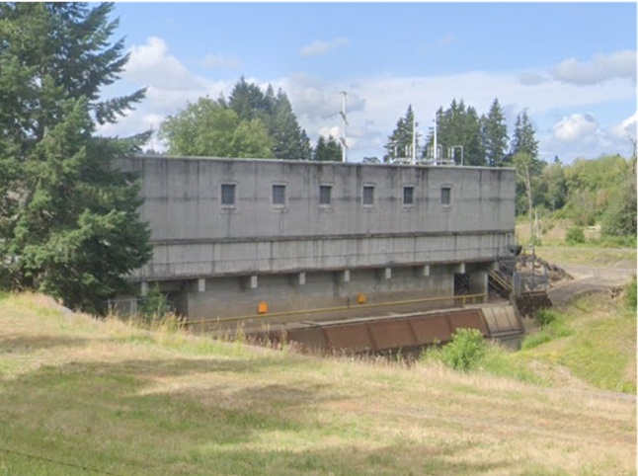
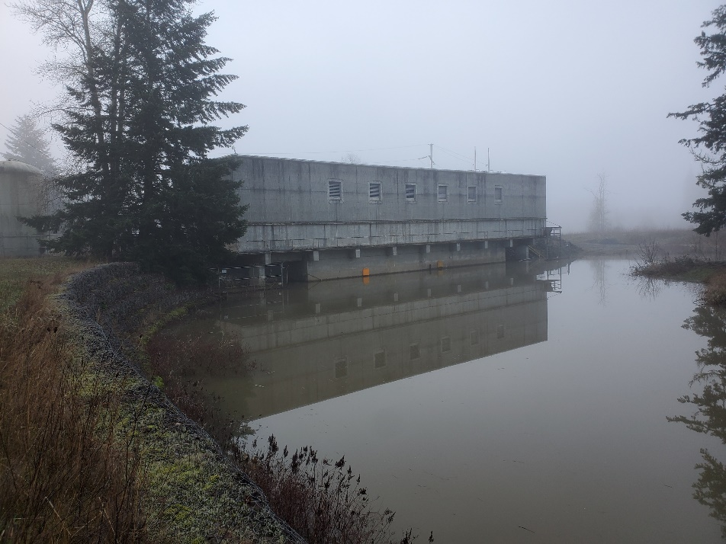
Spring Hill Pumping Plant
Shared with Tualatin Valley Irrigation District
Owned by the Bureau of Reclamation

Slide 9
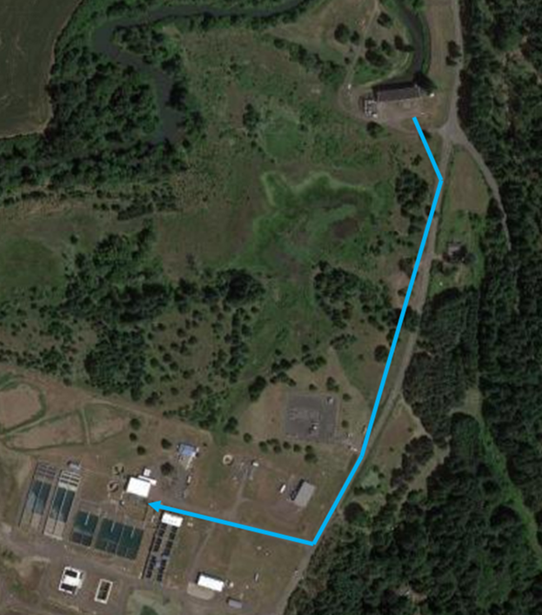
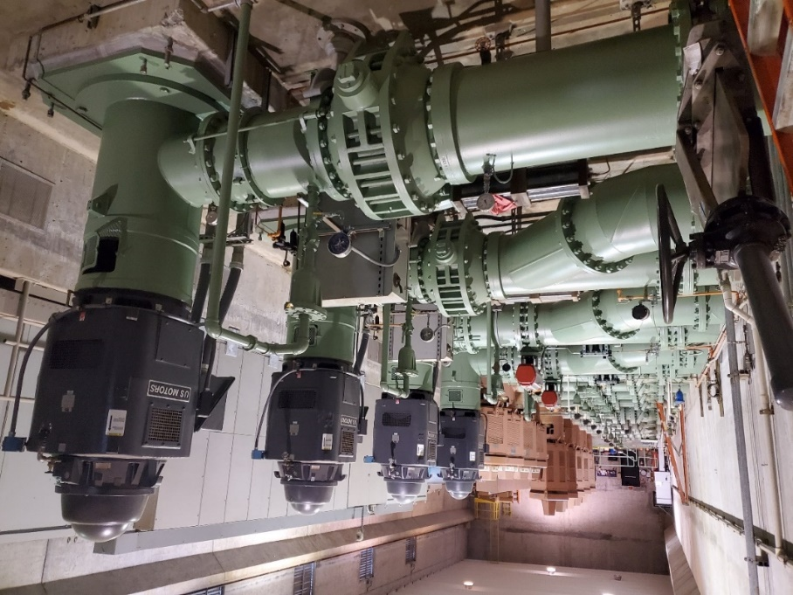
Raw Water Pumps
4 Pumps (Brand new)
400 HP/16,000 GPM each
2 Raw Water Pipelines to WTP
36” & 42”

Slide 10
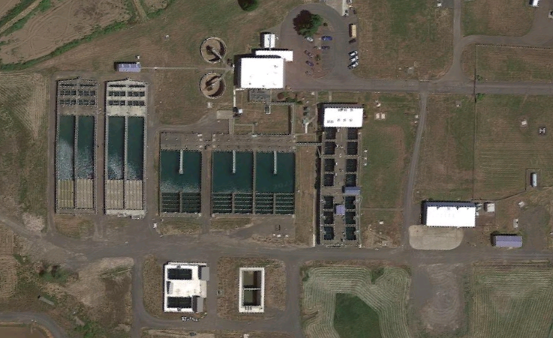
Rapid Mix
Notes:
Raw water enters the Rapid Mix.
Alum and Chlorine (Cl2) are added just prior to the Rapid Mix.
Caustic, Polymer, and Powdered Activated Carbon (PAC) can also be fed into the Rapid Mix when needed.

Slide 11
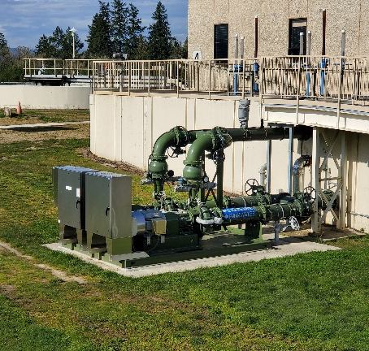
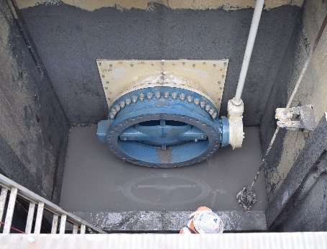
Rapid Mix
Alum and chlorine added (Powdered Activated Carbon and Caustic Soda if needed).
Rapid Mix Valve (new).
Rapid Mix Pumps (new).
Flow sent to Sedimentation Basins A-G.

Slide 12
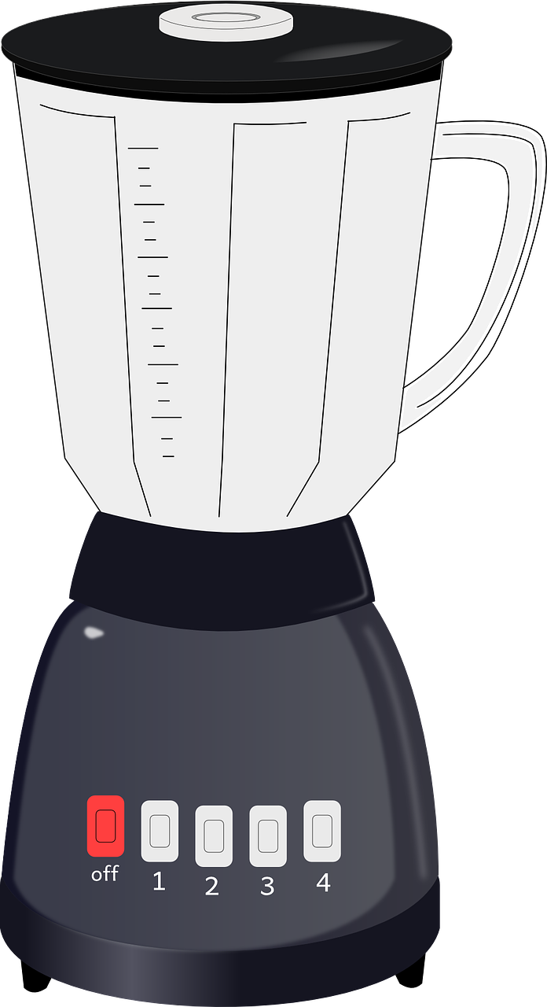
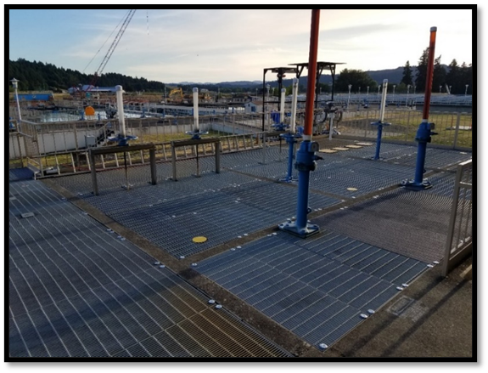
Rapid Mixing
Alum
Alum
Alum
Alum
Alum
Alum
Rapid Mix Chamber

Slide 13
Coagulation
Rapid Mix Chamber

Slide 14
Flocculation Chambers
Notes:
Flow travels through one of seven Flocculation Chambers- Sedimentation Basins.
New valve at Rapid Mix helps distribute flow to Flocculation Chambers-Sedimentation Basins.

Slide 15
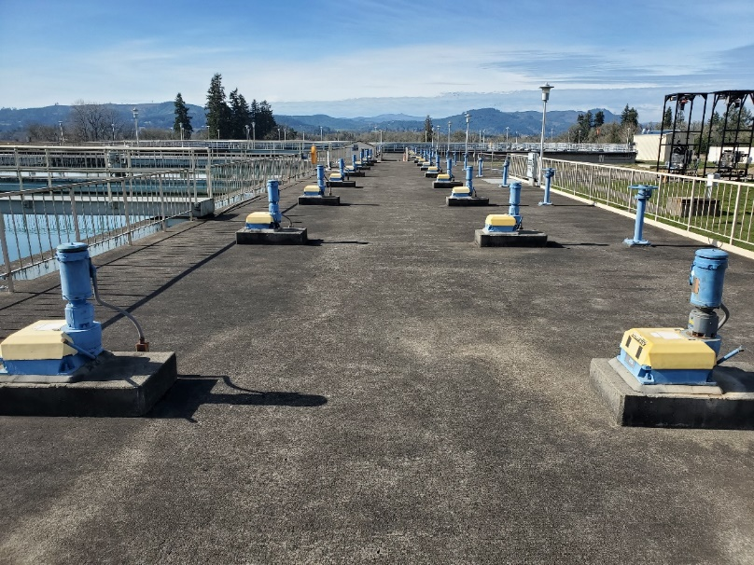
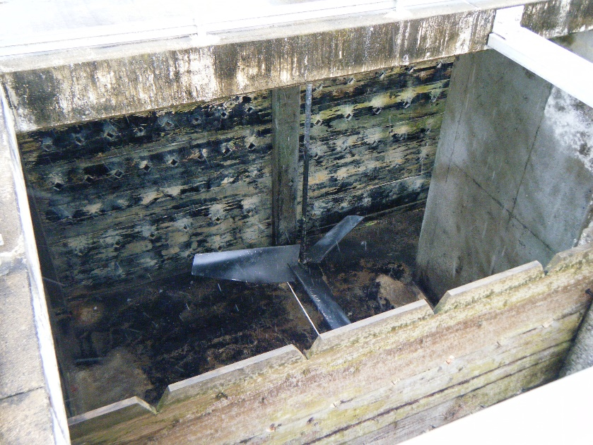
Flocculation Chambers

Slide 16
Sedimentation Basins
Notes:
After Flocculation Chambers water travels through the Basins.
Basins D-G have plate settlers to help with settling.

Slide 17
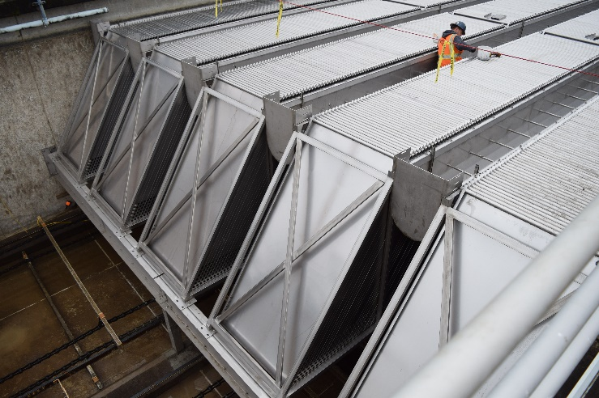
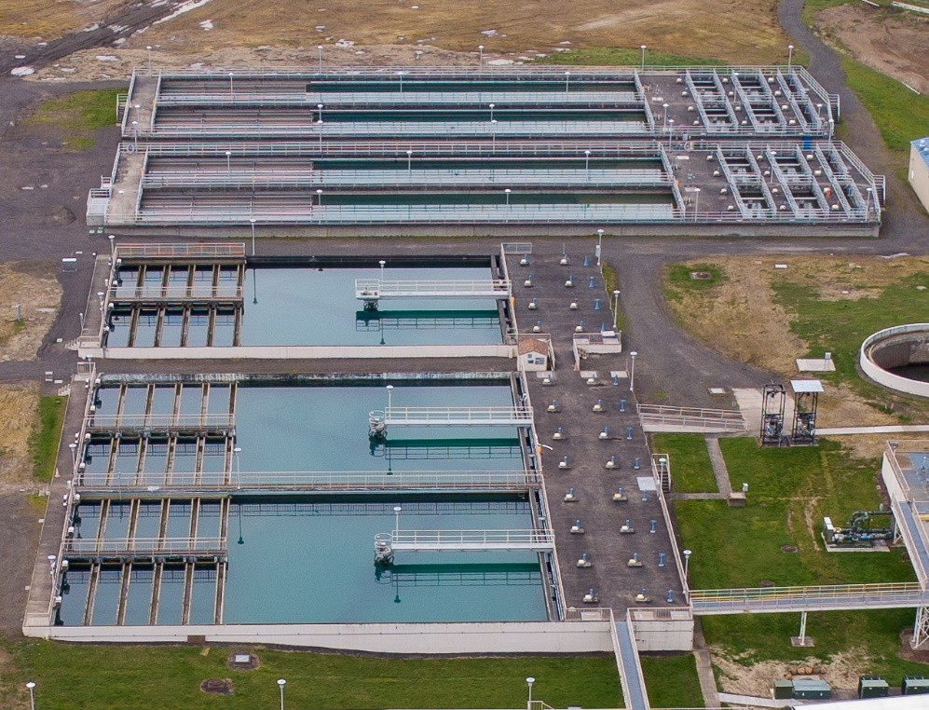
Sedimentation Basins
Basins D-G
Plate settlers D-G
Basins A-C

Slide 18
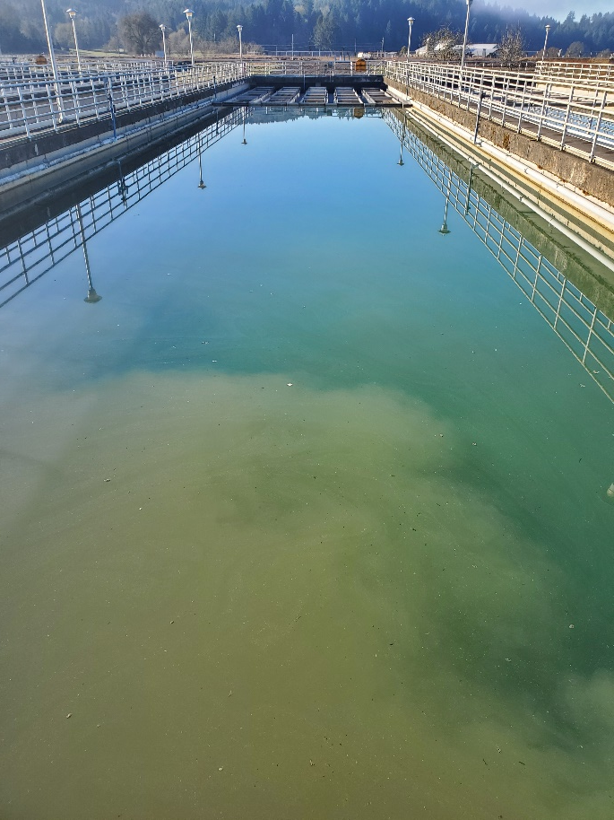
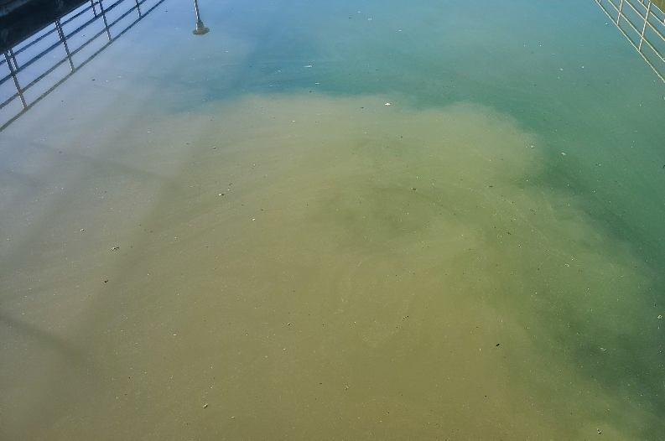
Sedimentation Basins (fall lines)

Slide 19
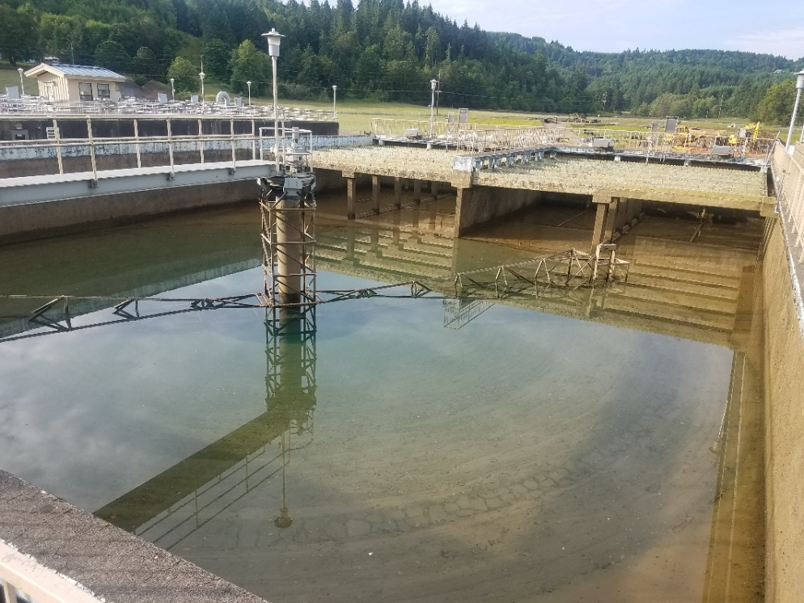
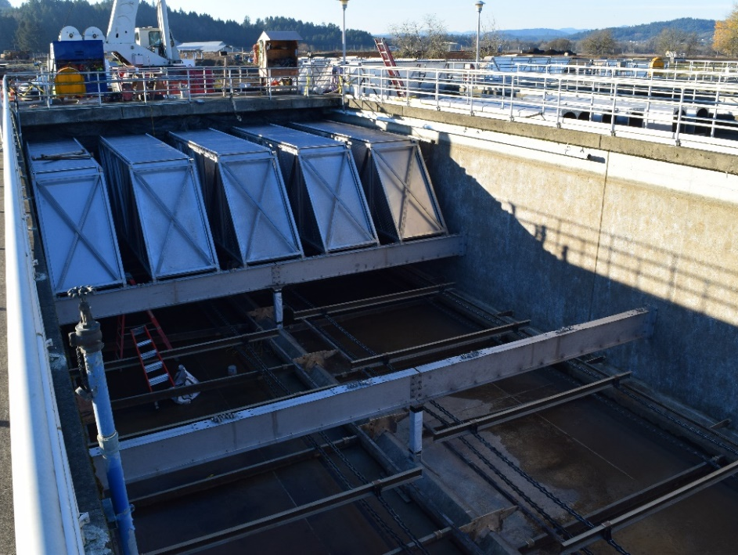
Sedimentation Basins (drained)
Basins A-C
Basins D-G

Slide 20
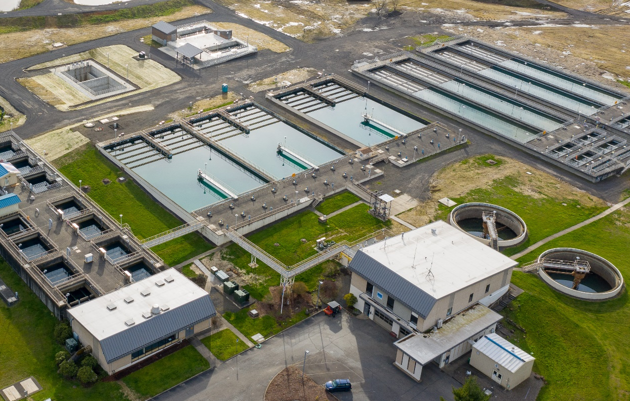
Flume
Runs at end of the Sedimentation Basins to Filters
Cl2 and Poly are added

Slide 21
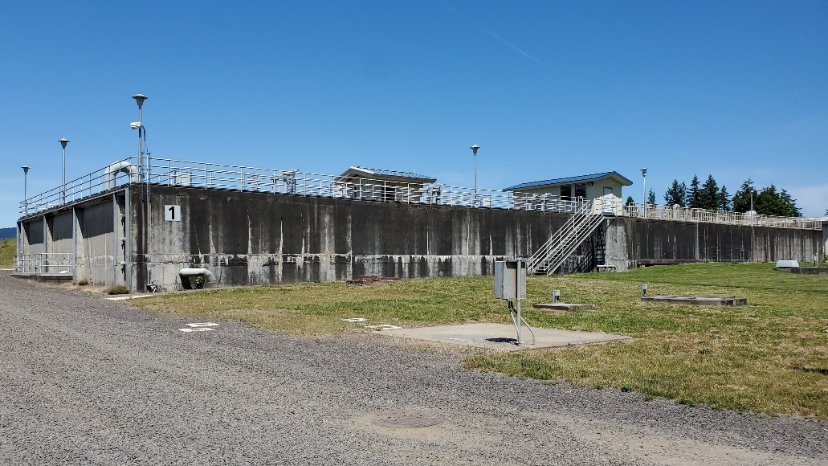
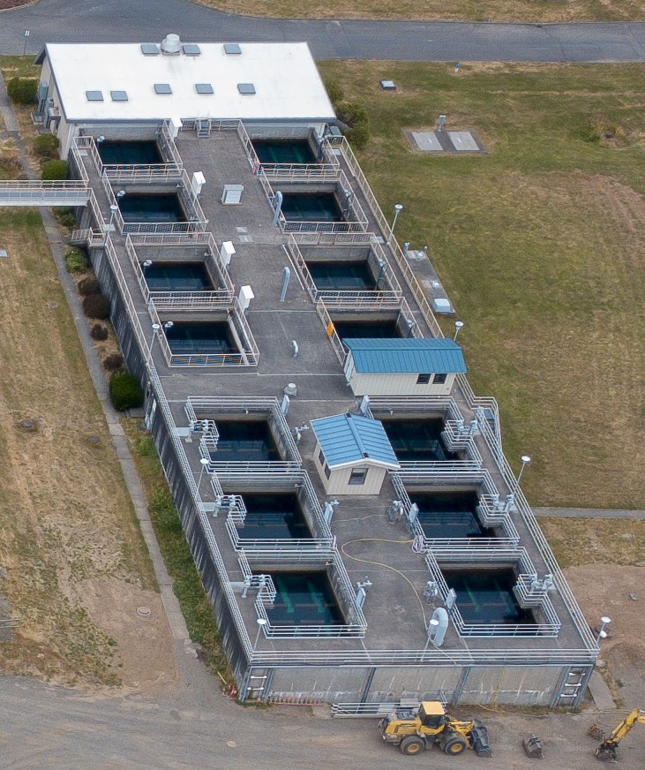
Filters 1-14
14 Filters x 462 sqft x 8.7 GPM/sf (4,019 GPM each filter)
Cl2 is added

Slide 22
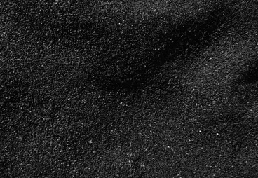

Filter Media
Configuration
Anthracite
Filters 1-14:
50” Anthracite
6” Sand
Total media depth: 56”
50in.
Sand
6in.
Notes:
S

Slide 23
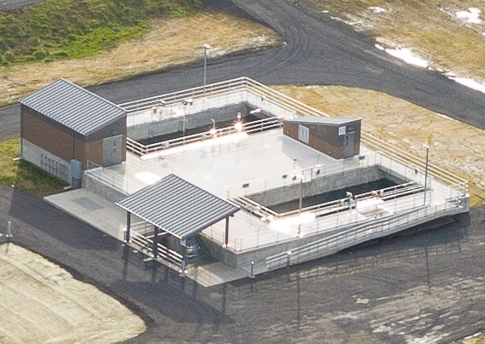
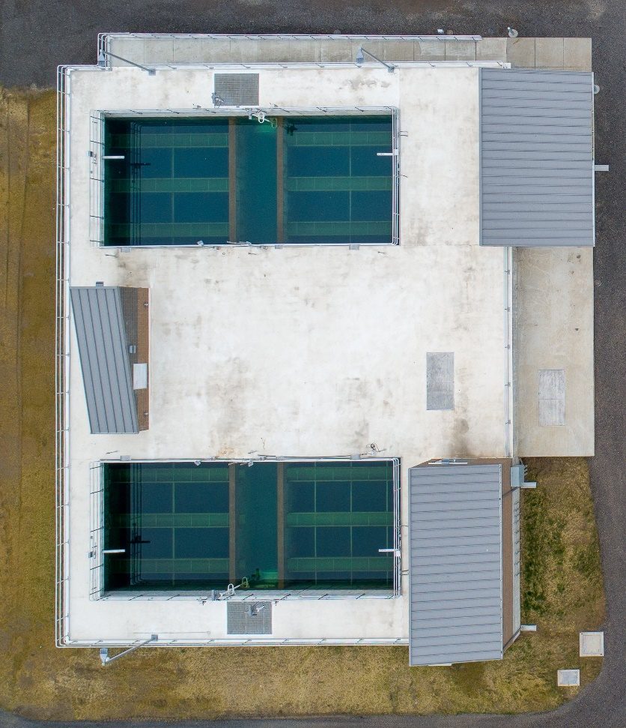
Filters 15-16
2 Filters x 924 sqft x 12 GPM/sf (11,088 GPM each filter)
Cl2 is added

Slide 24
Filter Media
Configuration
Anthracite
Filters 15-16:
72” Anthracite
12” Sand
Total media depth: 84”
72in.
Sand
12in.
Notes:
S

Slide 25
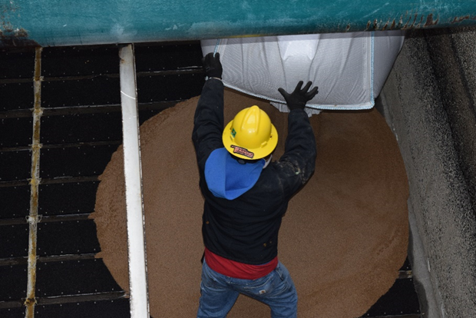
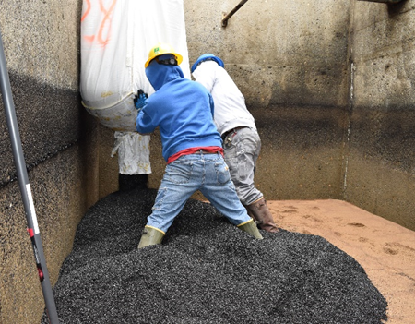
Filters: Media
Anthracite
Sand

Slide 26
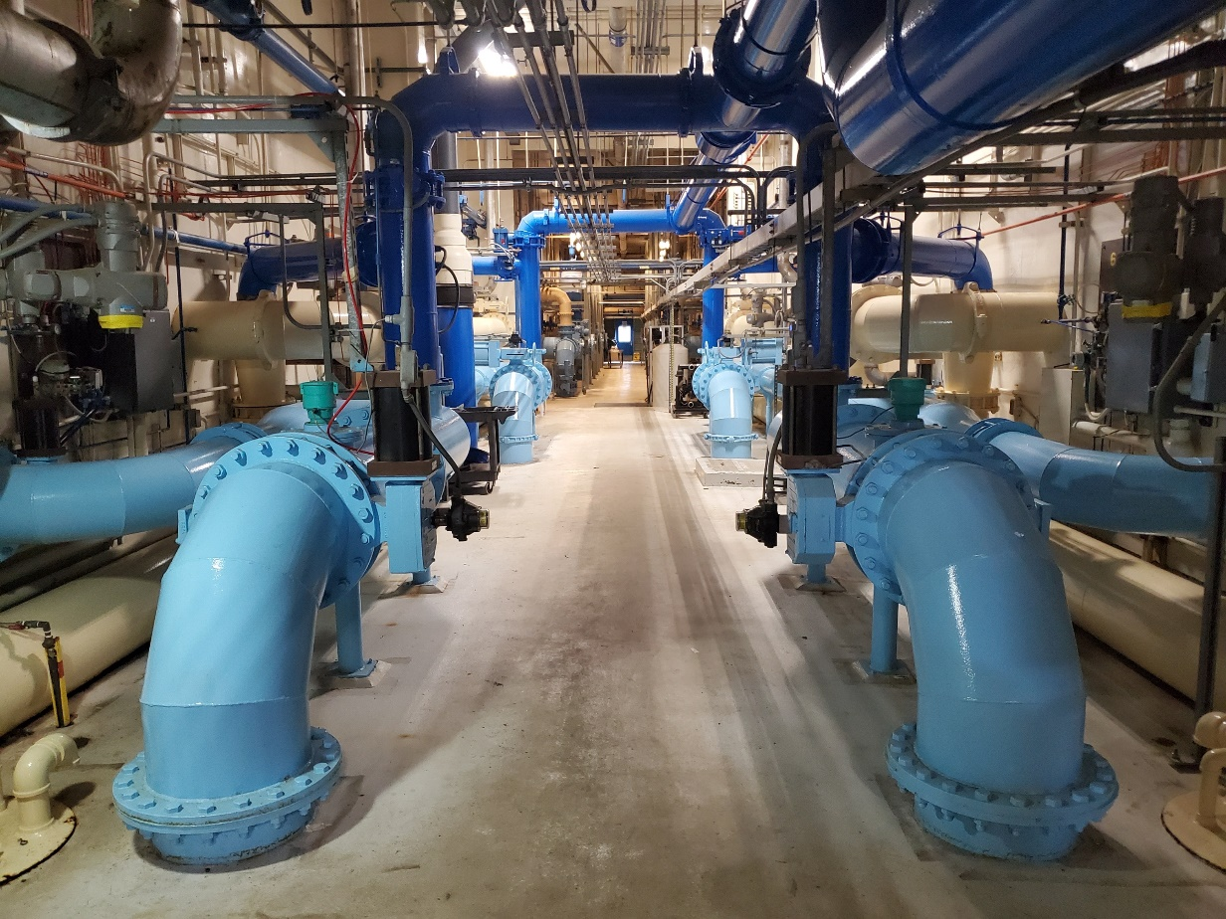
Pipe Gallery: Filters 1-14

Slide 27
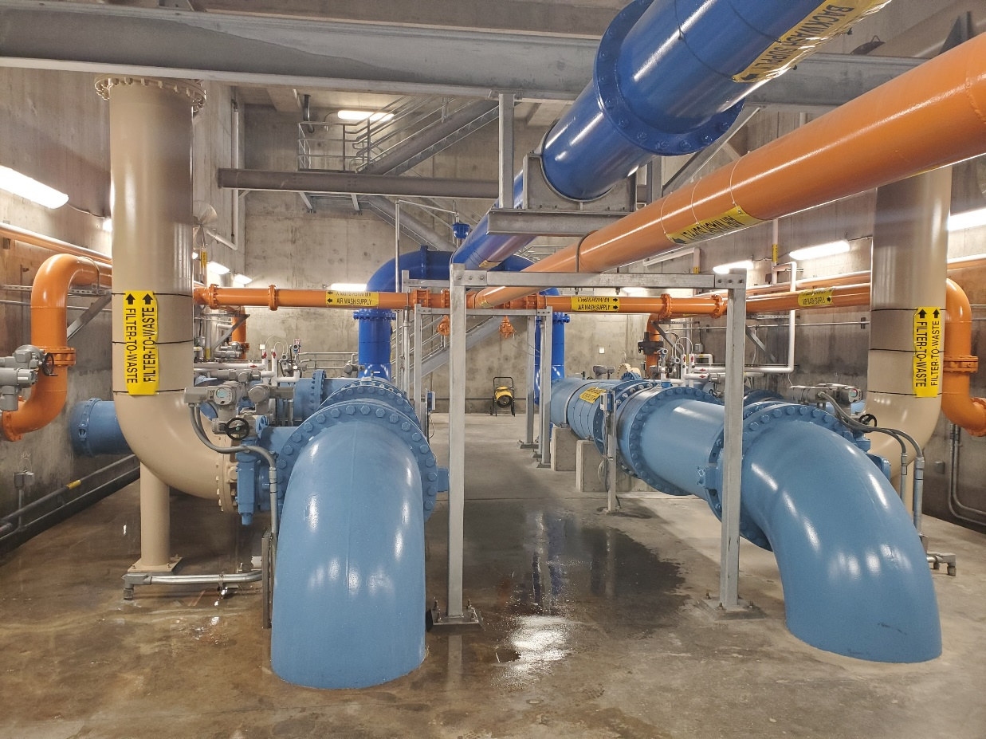
Pipe Gallery: Filters 15-16

Slide 28
Filters to Clearwell
Notes:
From the Filters, the water enters the Clearwell where more Cl2 is added along with Caustic for pH control. 1.2 Mgal of water
Clearwell = 1.2 Mgal

Slide 29
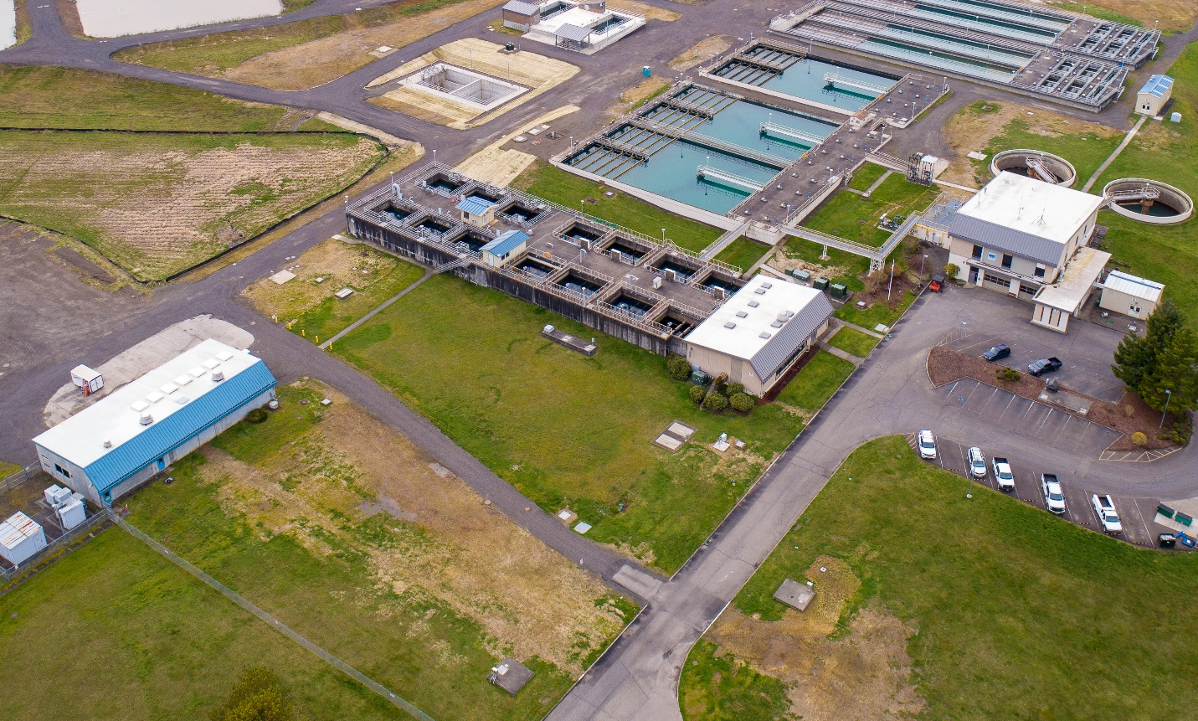
Clearwell
Caustic Soda is added
Cl2 is added
Holds 1.3 million gallons of water
1.3 MG

Slide 30
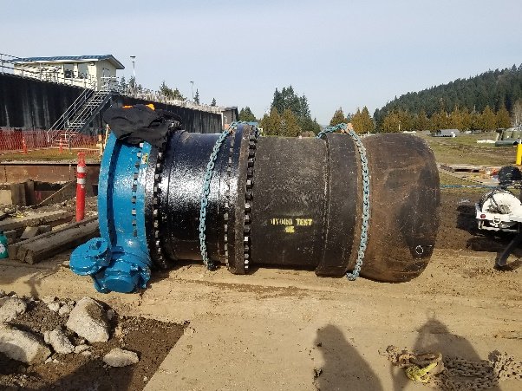
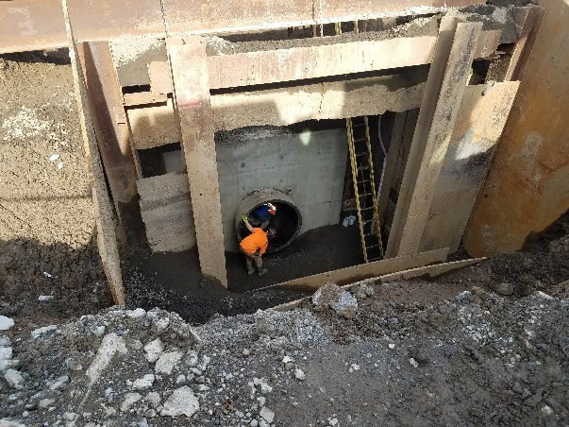
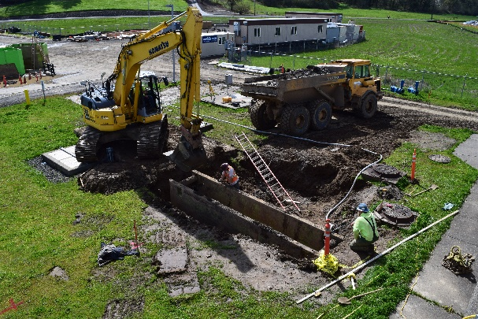
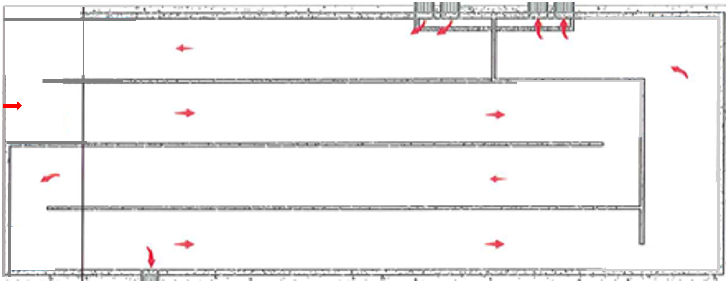
Clearwell

Slide 31
Finished Water Pump Stations
Notes:
From the Clearwell, the water is pumped out of the pump stations where Cl2 is added again.
Pump Station #1: 6 pumps = 32,000 GPM
Pump Station #2: 3 pumps = 27,000 GPM

Slide 32
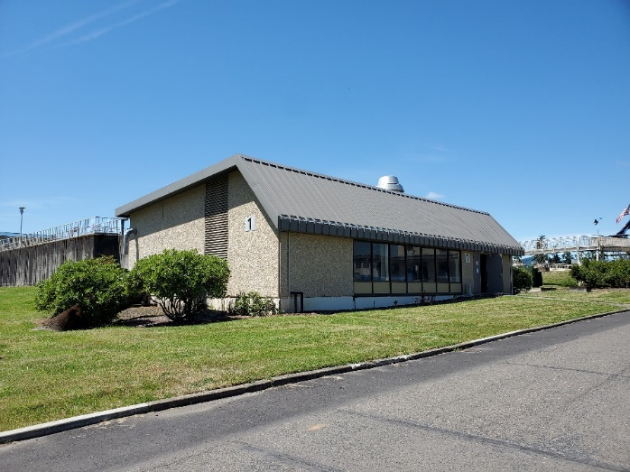
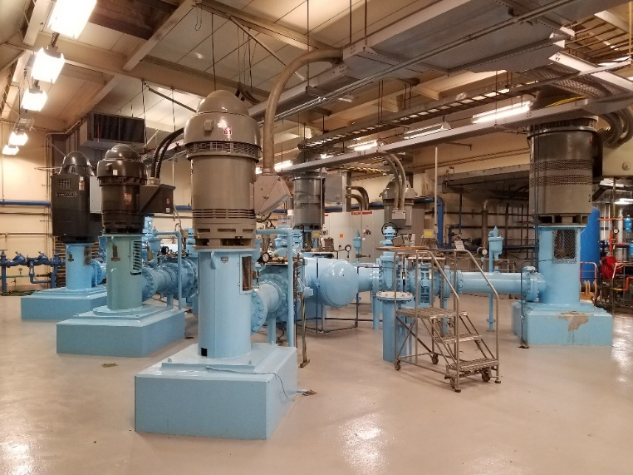
Finished Water Pump Station #1
Finished Water Pumps 1-6:
3 x 4,000 GPM
2 x 7,000 GPM
1 x 6,000 GPM
Cl2 is added

Slide 33
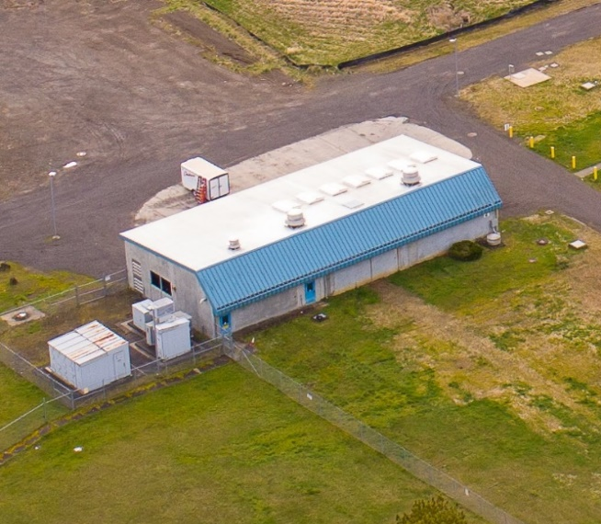
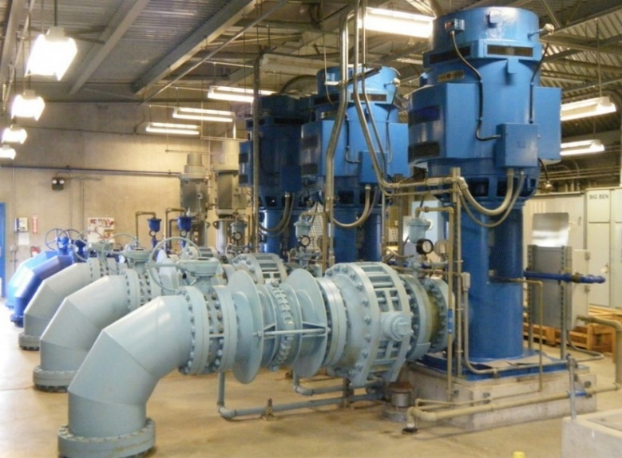
Finished Water Pump Station #2
Finished Water Pumps 7-9:
9,000 GPM each
Cl2 is added

Slide 34
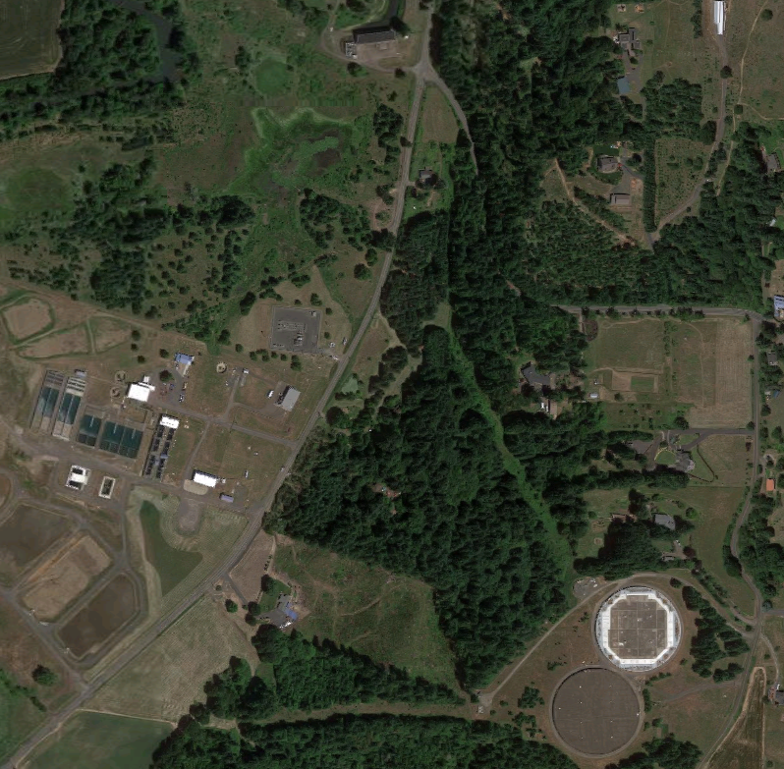
Water Pumped from
WTP to:
24” Forest Grove-Dilley Transmission Line
72” North Transmission Line (NTL)
45” South Transmission Line (STL)
Notes:
72” = 6’
Water leaves the treatment plant via the Forest Grove-Dilley transmission line into Forest Grove, via the North transition line that runs up to north Hillsboro and into Tualatin Valley Water District, and via the South Transition line from the Fern Hill Reservoirs into South Hillsboro and Beaverton.

Slide 35
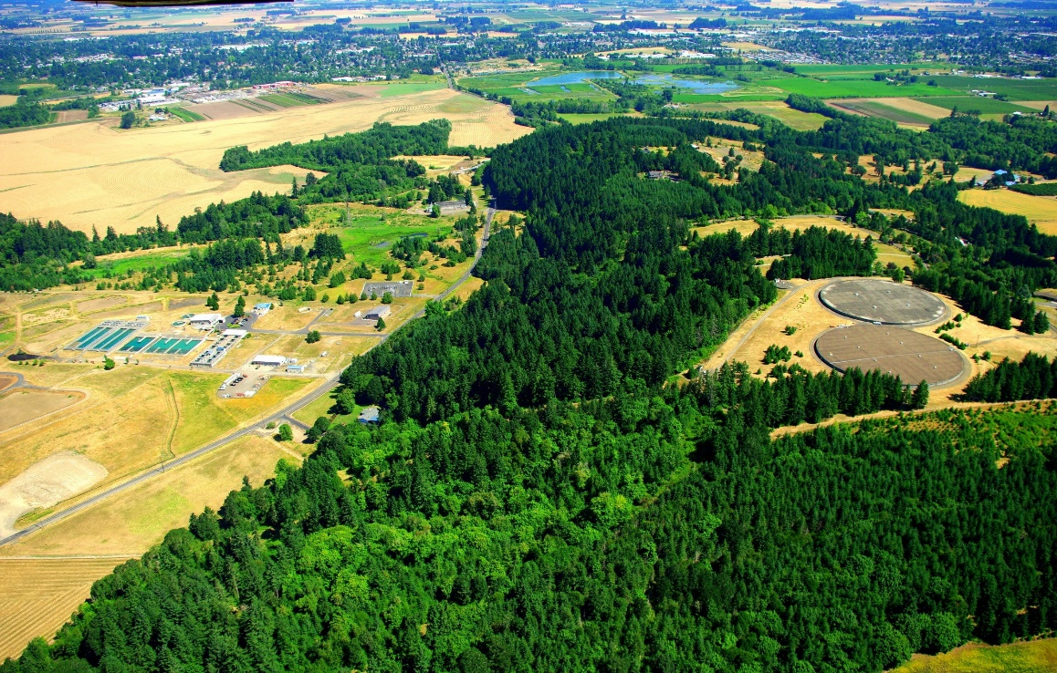
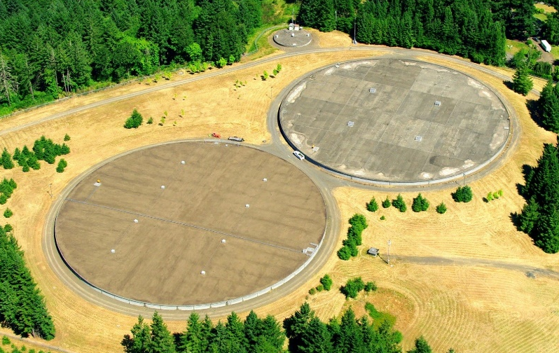
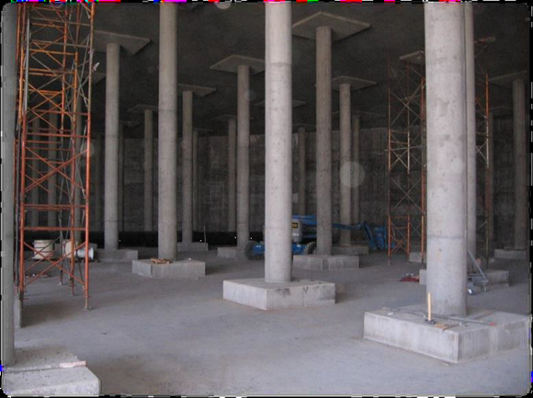
Fern Hill Reservoirs
2 Reservoirs 20 MG each

Slide 36
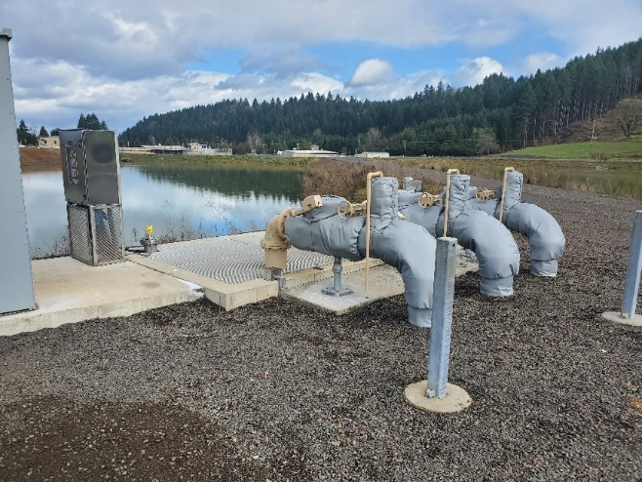

Recycled Water
Sludge from basins is sent out to one of the 5 Sludge Drying Beds (SDBs) via Solids Diversion Pump Station.
Backwash and Filter to Waste water also sent to SDBs via Surge Basins.
Water sent back from Decant Pump Station to RW pipeline to reenter treatment process.
Sludge gets hauled off after drying.

Slide 37

Sludge Removal

Slide 38

Surge Basins

Slide 39

Chemicals used in the Treatment Process

Slide 40



Chlorine
Chlorine (Cl2) is added for two reasons:
-To disinfect the water
-Maintain water safety all the way to the tap
Chlorine delivered once a week in the summer, and every two weeks in the winter (three 1 ton cylinders per load).

Slide 41




Aluminum Sulfate
Aluminum Sulfate (Alum) is used as coagulant to form flocculent
Alum delivered about once a week (2 truck loads per order).

Slide 42



Sodium Hydroxide
Sodium Hydroxide (Caustic Soda/NaOH) is added to raise the pH in order to prevent corrosion. Also used to raise pH in Rapid Mix during storm events.
Sodium Hydroxide is delivered about once a week in the summer, and every two weeks in the winter.

Slide 43



Filter Aid Polymer
Filter Aid Polymer (Poly) added to assist filters (FAP/Filter Aid Polymer)
Filter Aid Polymer delivered about every six months (18 bags per order).

Slide 44

Powdered Activated Carbon
Powder Activated Carbon (PAC) is used for Taste and Odors and algal toxins if required.
Powder Activated Carbon “super sacks” delivered via flat bed and stored mostly off-site.

Slide 45


Backup Power Facility
Backup Generators Online
2 x 2.5 MW Generators
Runs WTP at 37.5 MGD
PGE DSG (Dispatchable Standby Generation) Program
15,000-gallon diesel fuel tank
Enough fuel for 48 hours at full capacity

Slide 46

Operations
8 Operators (levels 1-4)
12 Hour shifts
7 days on 7 days off
Day and Night shift

Slide 47


Laboratory

Slide 48

1976
20 MGD
4 Filters
2 Sedimentation Basins (A-B)
1 FW Pump Station
And lots of Filbert trees!

Slide 49

2023
85 MGD
16 Filters
7 Sedimentation Basins (A-G)
2 FW Pump Stations
No more Filbert trees!

